Slide 2
Chapter 5
More SQL: Complex Queries, Triggers, Views, and Schema Modification

Slide 3
Chapter 5 Outline
More Complex SQL Retrieval Queries
Specifying Additional Constraints and Actions in SQL
  CREATE ASSERTION
  CREATE TRIGGER
Views (virtual tables) in SQL
  CREATE VIEW
Schema Modification in SQL
  ADD, DROP statements

Slide 4
Outline of Topics for More Complex SQL Retrieval Queries
Handling NULLs, 3-valued Logic in SQL
Nested Queries
  Correlated vs. uncorrelated
  EXISTS function
Joined Tables, Inner Joins, and Outer Joins
Aggregate Functions and Grouping in SQL
  COUNT, AVG, SUM, MIN, MAX functions
  GROUP BY, HAVING clauses

Slide 5
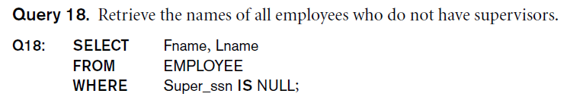
Handling NULLs in SQL
SQL allows queries that check if an attribute is NULL (missing, undefined or not applicable)
  Value unknown – a person’s DOB is not known
  Value not available/withheld – a person’s phone number
  Value not applicable – LastCollegeDegree value for a high school graduate
SQL uses IS or IS NOT to compare an attribute to NULL because it considers each NULL value distinct from other NULL values, so equality comparison is not appropriate.

Slide 6
3-valued Logic in SQL
Standard 2-valued logic assumes a condition can evaluate to either TRUE or FALSE
With NULLs a condition can evaluate to UNKNOWN, leading to 3-valued logic
Example: Consider a condition EMPLOYEE.DNO = 5; this evaluates for individual tuples in EMPLOYEE as follows:
  TRUE for tuples with DNO=5
  UNKNOWN for tuples where DNO is NULL
  FALSE for other tuples in EMPLOYEE

Slide 7
3-valued Logic in SQL (cont.)
Combining individual conditions using AND, OR, NOT logical connectives must consider UNKNOWN in addition to TRUE and FALSE
Next slide (Table 5.1) shows the truth tables for 3-valued logic

Slide 9
Nesting of Queries in SQL
A complete SELECT ... query, called a nested query, can be specified within the WHERE-clause of another query
  The other query is called the outer query
  Many of the previous queries can be specified in an alternative form using nesting
Query 1: Retrieve the name and address of all employees who work for the 'Research' department.
  Q1:SELECT FNAME, LNAME, ADDRESS
  FROM EMPLOYEE
  WHERE DNO IN (SELECT DNUMBER
  FROM DEPARTMENT
  WHERE DNAME='Research' ) ;
Comparison operator IN

Slide 10
Nesting of Queries in SQL
Tuples of values in comparisons by placing them in parenthesis
Select the Essns of all employees who work the same (project, hours) combination on some project that employee ‘John Smith’ whose Ssn=‘123456789’ works on.
  SELECT DISTINCT Essn
  FROM WORKS_ON
  WHERE (Pno, Hours) IN (SELECT Pno, Hours
  FROM WORKS_ON
  WHERE Essn=‘123456789’ ) ;
ANY/SOME or ALL key words can also be used
Name of employees whose salary is greater than salary of all employess working in department# 5
  SELECT Lname, Fname
  FROM EMPLOYEE
  WHERE Salary > ALL (SELECT Salary FROM EMPLOYEE
  WHERE Dno=5);

Slide 11
Nesting of Queries (cont.)
In Q1, the nested query selects the DNUMBER of the 'Research' department
The outer query select an EMPLOYEE tuple if its DNO value is in the result of the nested query
The comparison operator IN compares a value v with a set (or multi-set) of values V, and evaluates to TRUE if v is one of the elements in V
In general, can have several levels of nested queries
A reference to an unqualified attribute refers to the relation declared in the innermost nested query
In this example, the nested query is not correlated with the outer query

Slide 12
Nesting of Queries (cont.)
Attribute name ambiguity – USE aliases
Same attribute names exist in relations of outer query and relations of inner query, the rule is that a reference to an unqualified attribute refers to the relation declared in innermost nested query
Retrieve name of each employee who has a dependent with same first name and same sex as the employee
SELECT E.FNAME, E.LNAME
FROM EMPLOYEE AS E
WHERE E.SSN IN
(SELECT D.ESSN
FROM DEPENDENT AS D
WHERE E.FNAME=D.DEPENDENT_NAME
AND E.Sex=D.Sex) ;

Slide 13
Correlated Nested Queries
If a condition in the WHERE-clause of a nested query references an attribute of a relation declared in the outer query, the two queries are said to be correlated
  The result of a correlated nested query is different for each tuple (or combination of tuples) of the relation(s) the outer query
Query 12: Retrieve the name of each employee who has a dependent with the same first name as the employee.
Q12: SELECT E.FNAME, E.LNAME
FROM EMPLOYEE AS E
WHERE E.SSN IN
(SELECT D.ESSN
FROM DEPENDENT AS D
WHERE E.FNAME=D.DEPENDENT_NAME) ;

Slide 14
Correlated Nested Queries (cont.)
In Q12, the nested query has a different result for each tuple in the outer query (because it refers to E.FNAME)
A query written with nested SELECT... FROM... WHERE... blocks and using the = or IN comparison operators can always be expressed as a single block query.
For example, Q12 may be written as in Q12A
  Q12A: SELECT E.FNAME, E.LNAME
  FROM EMPLOYEE E, DEPENDENT D
  WHERE E.SSN=D.ESSN AND E.FNAME=D.DEPENDENT_NAME ;

Slide 15
Correlated Nested Queries (cont.)
The original SQL as specified for SYSTEM R also had a CONTAINS comparison operator, which is used in conjunction with nested correlated queries
  This operator was dropped from the language, possibly because of the difficulty in implementing it efficiently
  Most implementations of SQL do not have this operator
  The CONTAINS operator compares two sets of values, and returns TRUE if one set contains all values in the other set
    Reminiscent of the division operation of algebra (see Chapter 6)

Slide 16
Correlated Nested Queries (cont.)
Example of Using CONTAINS (not in current SQL)
Query 3: Retrieve the name of each employee who works on all the projects controlled by department number 5.
  Q3: SELECT E.FNAME, E.LNAME
  FROM EMPLOYEE AS E
  WHERE ( (SELECT W.PNO
  FROM WORKS_ON AS W
  WHERE E.SSN=W.ESSN)
  CONTAINS
  (SELECT P.PNUMBER
  FROM PROJECT AS P
  WHERE P.DNUM=5) ) ;

Slide 17
Correlated Nested Queries (cont.)
In Q3, the second nested query, which is not correlated with the outer query, retrieves the project numbers of all projects controlled by department 5
The first nested query, which is correlated, retrieves the project numbers on which the employee works; this is different for each employee tuple because it references E.SSN

Slide 18
The EXISTS Function in SQL
EXISTS is used to check whether the result of a query is empty (contains no tuples) or not (contains one or more tuples)
  Applied to a query, but returns a boolean result (TRUE or FALSE)
  Can be used in the WHERE-clause as a condition
  EXISTS (Q) evaluates to TRUE if the result of Q has one or more tuple; evaluates to FALSE if the result of Q has no tuples

Slide 19
The EXISTS Function (cont.)
Query 7: Retrieve the names of employees who are department managers and have at least one dependent.
  Q7: SELECT M.Fname, M.Lname
  FROM EMPLOYEE AS M
  WHERE EXISTS (SELECT *
  FROM DEPENDENT
  WHERE M.Ssn=Essn) AND EXISTS (SELECT * FROM DEPARTMENT WHERE M.Ssn=Mgr_ssn) ;

Slide 20
The EXISTS Function (cont.)
Query 6: Retrieve the names of employees who have no dependents.
  Q6: SELECT E.FNAME, E.LNAME
  FROM EMPLOYEE E
  WHERE NOT EXISTS (SELECT *
  FROM DEPENDENT D
  WHERE E.Ssn=D.Essn) ;
In Q6, the correlated nested query retrieves all DEPENDENT tuples related to an EMPLOYEE tuple. If none exist, the EMPLOYEE tuple is selected
  EXISTS is necessary for the expressive power of SQL

Slide 21
Explicit (Literal) Sets in SQL
An explicit (enumerated) set of values is enclosed in parentheses
Query 13: Retrieve the social security numbers of all employees who work on project number 1, 2, or 3.
  Q13: SELECT DISTINCT ESSN
  FROM WORKS_ON
  WHERE PNO IN (1, 2, 3) ;

Slide 22
Joined Tables (Relations) in SQL
Can specify a "joined relation" in the FROM-clause
  Looks like any other relation but is the result of a join
  Allows the user to specify different types of joins (INNER JOIN, NATURAL JOIN, LEFT OUTER JOIN, RIGHT OUTER JOIN, CROSS JOIN, etc) – see the next slides
  Each join type can specify a different query and produce a different result

Slide 23
Types of join – INNER JOIN
This is the regular join operation, default type of join
Joined tuples must satisfy all join conditions
Only matching tuples in result
The FROM clause contains a single joined table. Attributes of this table are attributes of DEPARTMENT, followed by all attributes of EMPLOYEE
Example: Query QJ1: Retrieve the employee names with the names of the department they work for
SELECT E.FNAME, E.LNAME, D.DNAME
FROM DEPARTMENT AS D, EMPLOYEE AS E
WHERE D.DNUMBER=E.DNO ;
This can be written using joined tables as follows:
SELECT E.FNAME, E.LNAME, D.DNAME
FROM (DEPARTMENT AS D JOIN EMPLOYEE AS E ON D.DNUMBER=E.DNO) ;

Slide 24
Types of join – OUTER JOIN
In QJ1, an EMPLOYEE record is joined only if it has a matching DEPARTMENT with D.DNUMBER=E.DNO
Hence, an EMPLOYEE with NULL for E.DNO will not appear in the query result
Also, a DEPARTMENT that has no matching EMPLOYEE records (i.e. currently has no employees) does not appear in the query result
OUTER JOINs gives the options to include every EMPLOYEE record or every DEPARTMENT record in the query results
A record that does not have a matching joined record will be “padded” with an imaginary “NULL record” from the other table (all its attributes will be NULL)

Slide 25
Types of join – LEFT OUTER JOIN
Example: Query QJ2: Retrieve the employee names with the names of the department they work for; every department must appear in the result even if it has no employees
This can be written using joined tables as follows:
SELECT E.FNAME, E.LNAME, D.DNAME
FROM (DEPARTMENT AS D LEFT OUTER JOIN EMPLOYEE AS E ON D.DNUMBER=E.DNO) ;
Note: An earlier left outer join syntax in ORACLE is as follows:
SELECT E.FNAME, E.LNAME, D.DNAME
FROM DEPARTMENT AS D, EMPLOYEE AS E
WHERE D.DNUMBER += E.DNO ;

Slide 26
Types of join – RIGHT OUTER JOIN
Example: Query QJ3: Retrieve the employee names with the names of the department they work for; every employee must appear in the result even they are not currently assigned to a department
This can be written using joined tables as follows:
SELECT E.FNAME, E.LNAME, D.DNAME
FROM (DEPARTMENT AS D RIGHT OUTER JOIN EMPLOYEE AS E ON D.DNUMBER=E.DNO) ;
Note: An earlier left outer join syntax in ORACLE is as follows:
SELECT E.FNAME, E.LNAME, D.DNAME
FROM DEPARTMENT AS D, EMPLOYEE AS E
WHERE D.DNUMBER =+ E.DNO ;

Slide 27
Types of join – FULL OUTER JOIN
Example: Query QJ4: Retrieve the employee names with the names of the department they work for; every employee and every department must appear in the result
This can be written using joined tables as follows:
SELECT E.FNAME, E.LNAME, D.DNAME
FROM (DEPARTMENT AS D FULL OUTER JOIN EMPLOYEE AS E ON D.DNUMBER=E.DNO) ;
Note: An earlier left outer join syntax in ORACLE is as follows:
SELECT E.FNAME, E.LNAME, D.DNAME
FROM DEPARTMENT AS D, EMPLOYEE AS E
WHERE D.DNUMBER +=+ E.DNO ;

Slide 28
Types of join – NATURAL JOIN
If the join attributes in both tables have the same name, the join condition can be left out (it is automatically added by the system)
NATURAL JOIN is a form of inner join
Example: QJ5: We rename DNUMBER in DEPARTMENT to DNO to match the join attribute name (DNO) in EMPLOYEE (we also rename other attributes)
Implicit join condition is E.DNO = D.DNO
SELECT E.FN, E.LN, E. ADR
FROM (DEPARTMENT AS D(DNM, DNO, MSSN, STRDATE)
NATURAL JOIN
EMPLOYEE AS E(FN,MI,LN,S,BD,ADR,SX,SAL,SU,DNO) ;

Slide 29
Joined Tables – Other Examples
Query 8: Retrieve the employee names, and the names of their direct supervisor
  Q8:SELECT E.FNAME, E.LNAME, S.FNAME, S.LNAME
  FROM (EMPLOYEE AS E INNER JOIN EMPLOYEE AS S ON E.SUPERSSN=S.SSN);
In Q8, an employee with no supervisor will not appear in the result; if we want every employee to appear, we write:
  Q8':SELECT E.FNAME, E.LNAME, S.FNAME, S.LNAME
  FROM (EMPLOYEE E LEFT OUTER JOIN EMPLOYEE S ON E.SUPERSSN=S.SSN)

Slide 30
Joined Tables – Other Examples
Examples:
  Q1:SELECT FNAME, LNAME, ADDRESS
  FROM EMPLOYEE, DEPARTMENT
  WHERE DNAME='Research' AND DNUMBER=DNO ;
could be written as:
  Q1:SELECT FNAME, LNAME, ADDRESS
  FROM (EMPLOYEE JOIN DEPARTMENT
  ON DNUMBER=DNO)
  WHERE DNAME='Research’ ;
or as:
  Q1:SELECT FNAME, LNAME, ADDRESS
  FROM (EMPLOYEE NATURAL JOIN DEPARTMENT
  AS DEPT(DNAME, DNO, MSSN, MSDATE))
  WHERE DNAME='Research’ ;

Slide 31
Joined Tables – Other Examples
Another Example: Q2 could be written as follows; this illustrates multiple joins in the joined tables
  Q2:SELECT PNUMBER, DNUM, LNAME, BDATE, ADDRESS
  FROM ((PROJECT JOIN DEPARTMENT ON DNUM=DNUMBER) JOIN EMPLOYEE ON MGRSSN=SSN) )
  WHERE PLOCATION='Stafford’ ;

Slide 32
Aggregate Functions
Include COUNT, SUM, MAX, MIN, and AVG
These can summarize information from multiple tuples into a single tuple summary.
Grouping is used to create subgroups of tuples before summarization
Query 15: Find the maximum salary, the minimum salary, and the average salary among all employees.
  Q15: SELECT MAX(SALARY) AS HIGH_SAL, MIN(SALARY) AS LOW_SAL,
  AVG(SALARY) AS MEAN_SAL
  FROM EMPLOYEE ;

Slide 33
Aggregate Functions (cont.)
Query 16: Find the maximum salary, the minimum salary, and the average salary among employees who work for the 'Research' department.
  Q16: SELECT MAX(E.SALARY), MIN(E.SALARY), AVG(E.SALARY)
  FROM EMPLOYEE E, DEPARTMENT D
  WHERE E.DNO=D.DNUMBER AND D.DNAME='Research' ;

Slide 34
Aggregate Functions (cont.)
Queries 17 and 18: Retrieve the total number of employees in the company (Q17), and the number of employees in the 'Research' department (Q18). (Note: COUNT(*) counts the number of selected records)
  Q17: SELECT COUNT (*)
  FROM EMPLOYEE ;
  Q18: SELECT COUNT (*)
  FROM EMPLOYEE AS E, DEPARTMENT AS D
  WHERE E.DNO=D.DNUMBER AND D.DNAME='Research’ ;

Slide 35
Grouping (Partitioning Records into Subgroups)
In many cases, we want to apply the aggregate functions to subgroups of tuples in a relation
Each subgroup of tuples consists of the set of tuples that have the same value for the grouping attribute(s) – for example, employees who work in the same department (have the same DNO)
The aggregate functions are applied to each subgroup independently
SQL has a GROUP BY-clause for specifying the grouping attributes, which must also appear in the SELECT-clause

Slide 36
Grouping (cont.)
Query 20: For each department, retrieve the department number, the number of employees in the department, and their average salary.
  Q20: SELECT DNO, COUNT (*), AVG (SALARY)
  FROM EMPLOYEE
  GROUP BY DNO ;
  In Q20, the EMPLOYEE tuples are divided into groups-
    Each group has same value for the grouping attribute DNO
  The COUNT and AVG functions are applied to each such group of tuples separately (see Figure 5.1(a), next slide)
  The SELECT-clause includes only the grouping attribute and the functions to be applied on each group of tuples

Slide 37
Continued next page…

Slide 38
Grouping (cont.)
A join condition can be used with grouping
Query 21: For each project, retrieve the project number, project name, and the number of employees who work on that project.
  Q21: SELECT P.PNUMBER, P.PNAME, COUNT (*)
  FROM PROJECT AS P, WORKS_ON AS W
  WHERE P.PNUMBER=W.PNO
  GROUP BY P.PNUMBER, P.PNAME ;
  - Join condition in conjunction with Group By
  In this case, the grouping and aggregate functions are applied after the joining of the two relations

Slide 39
The HAVING-clause
Sometimes we want to retrieve the values of these aggregate functions for only those groups that satisfy certain conditions
The HAVING-clause is used for specifying a selection condition on groups (rather than on individual tuples)

Slide 40
The HAVING-Clause (cont.)
Query 22: For each project on which more than two employees work, retrieve the project number, project name, and the number of employees who work on that project (Figure 5.1(b) – next two slides).
  Q22: SELECT PNUMBER, PNAME, COUNT(*)
  FROM PROJECT, WORKS_ON
  WHERE PNUMBER=PNO
  GROUP BY PNUMBER, PNAME
  HAVING COUNT(*) > 2 ;

Slide 41
Continued next page…

Slide 42
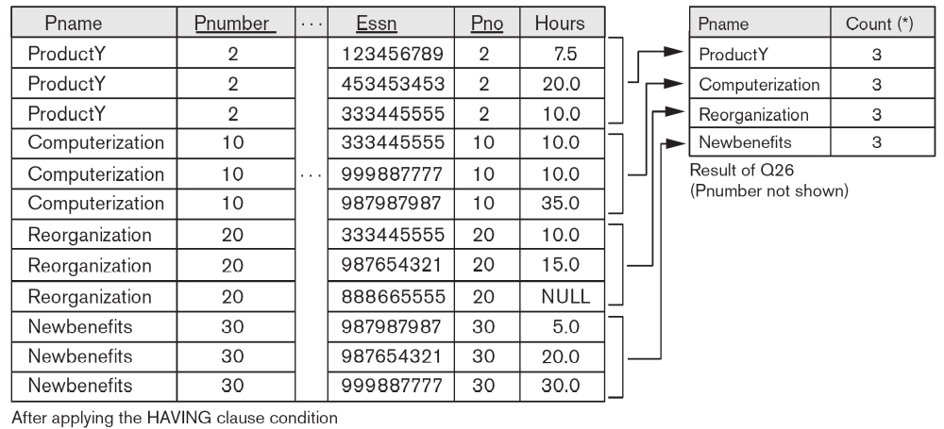

Slide 43
Summary of SQL Queries
A query in SQL can consist of up to six clauses, but only the first two, SELECT and FROM, are mandatory. The clauses are specified in the following order:
SELECT <attribute list>
FROM <table list>
[WHERE <condition>]
[GROUP BY <grouping attribute(s)>]
[HAVING <group condition>]
[ORDER BY <attribute list>] ;

Slide 44
Summary of SQL Queries (cont.)
The SELECT-clause lists the attributes or functions to be retrieved
The FROM-clause specifies all relations (or aliases) needed in the query but not those needed in nested queries, as well as joined tables
The WHERE-clause specifies the conditions for selection and join of tuples from the relations specified in the FROM-clause
GROUP BY specifies grouping attributes
HAVING specifies a condition for selection of groups
ORDER BY specifies an order for displaying the query result
  Conceptually, a query is evaluated by first applying the FROM clause followed by WHERE-clause, then GROUP BY and HAVING, and finally the SELECT-clause and ORDER BY

Slide 45
Specifying General Constraints as Assertions in SQL
General constraints: constraints that do not fit in the basic SQL constraints (primary keys, UNIQUE, entity integrity, referential integrity (foreign keys), NOT NULL – see Chapter 4)
Mechanism: CREATE ASSERTION
  Components include:
    a constraint name,
    followed by CHECK,
    followed by a condition that must be TRUE

Slide 46
Assertions: An Example
“The salary of an employee must not be greater than the salary of the manager of the department that the employee works for’’
CREATE ASSERTION SALARY_CONSTRAINT
CHECK (NOT EXISTS (SELECT *
FROM EMPLOYEE E, EMPLOYEE M, DEPARTMENT D
WHERE E.SALARY > M.SALARY AND
E.DNO=D.NUMBER AND D.MGRSSN=M.SSN))
    constraint name,
    CHECK,
    condition

Slide 47
Using General Assertions
1. Specify a query that violates the condition; include inside a NOT EXISTS clause
2. Query result must be empty; apply NOT EXISTS to it in the CHECK clause
3. If the query result is not empty, the assertion has been violated (CHECK will evaluate to FALSE)

Slide 48
SQL Triggers
- Used to monitor a database and initiate action when certain events and conditions occur (see Section 26.1 for details)
- Triggers are expressed in a syntax similar to assertions and include the following:
  Event
    Such as an insert, delete, or update operation
  Condition
  Action
    To be taken when the condition is satisfied

Slide 49
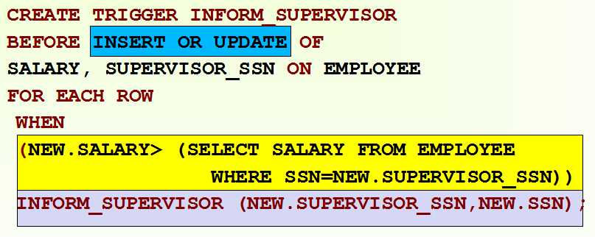
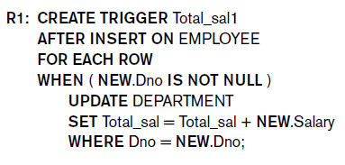
SQL Triggers: Examples
A trigger to compare an employee’s salary to his/her supervisor during insert or update operations:

Slide 50
Views in SQL
- A view is a “virtual” table that is derived from other tables (base tables or previously defined views)
- Allows for limited update operations (since the table may not physically be stored)
- Allows full query operations
- A convenience for defining complex operations once and reusing the definition
- Can also be used as a security mechanism

Slide 51
Specification of Views
SQL command: CREATE VIEW
  - a virtual table (view) name
  - a possible list of attribute names (for example, when arithmetic operations are specified or when we want the names to be different from the attributes in the base relations)
  - a query to specify the view contents

Slide 52
SQL Views: An Example
- Specify a virtual DEPT_INFO table to summarize departmental information
- Makes it easier to query without having to specify the aggregate functions, GROUP BY, and HAVING
CREATE VIEW DEPT_INFO(DNO, NO_EMPS, TOTAL_SAL) AS
SELECT DNO, COUNT(*), SUM(SALARY)
FROM EMPLOYEE
GROUP BY DNO;

Slide 53
Querying the View
- We can specify SQL retrieval queries on a view table, same as on a base table:
SELECT DNO
FROM DEPT_INFO
WHERE NO_EMPS > 100;
- Can also specify joins and other retrieval operations on the view

Slide 54

SQL Views: Another Example
- Specify a virtual WORKS_ON table (called WORKS_ON1), with EMPLOYEE and PROJECT names (instead of numbers)
- This makes it easier to query by names without having to specify the two join conditions
CREATE VIEW WORKS_ON1 AS
SELECT FNAME, LNAME, PNAME, HOURS
FROM EMPLOYEE, PROJECT, WORKS_ON
WHERE SSN=ESSN AND PNO=PNUMBER;

Slide 55


Querying a View (cont.)
We can specify SQL retrieval queries on a view table, same as on a base table:
When no longer needed, a view can be dropped:

Slide 56
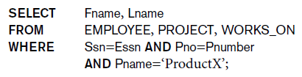
View Implementation
- View implementation is hidden from the user
- Two main techniques
1. Query modification:
  DBMS automatically modifies the view query into a query on the underlying base tables, QV1 to
Disadvantage:
  Inefficient for views defined via complex queries
    Especially if many queries are to be applied to the view within a short time period

Slide 57
View Implementation (cont.)
2. View materialization:
  - Involves physically creating and keeping a temporary table that holds the view query result
  - Assumes that other queries on the view will follow
Concerns:
  - Maintaining correspondence between the base tables and view when the base tables are updated
Strategy:
  - Incremental update of the temporary view table

Slide 58
Updating of Views
- All views can be queried for retrievals, but many views cannot be updated
- Update on a view on a single table without aggregate operations:
  If view includes key and NOT NULL attributes, view update may map to an update on the base table
- Views involving joins and aggregate functions are generally not updatable unless they can be mapped to unique updates on the base tables

Slide 59
Checking Views for Updatability
- When a user intends to update a view, must add the clause WITH CHECK OPTION at the end of the CREATE VIEW statement
  - This allows the system to check for updatability
  - If view is not updatable, and error will be generated
  - If view is updatable, system will create a mapping strategy to process view updates

Slide 60
Schema modification in SQL
- There are two commands for modifying schema constructs
  - DROP statement can remove named schema constructs, such as tables, constraints, assertions, views, and even schemas
  - ALTER statement can be used to change a table by adding or dropping of attributes and table constraints

Slide 61
Example: DROP TABLE
Used to remove a relation (base table) and its definition
The relation can no longer be used in queries, updates, or any other commands since its description no longer exists
Example:
DROP TABLE DEPENDENT;

Slide 62
Example: DROP TABLE (cont.)
If the table being dropped is referenced from other tables, it cannot be dropped and an error is generated
By adding CASCADE, all references to the table are automatically removed
Example:
DROP TABLE DEPENDENT CASCADE;

Slide 63
Example: ALTER TABLE
Can be used to add or drop an attribute from a base relation
  Suppose we want to remove the attribute BDATE from the EMPLOYEE table
Example:
ALTER TABLE EMPLOYEE DROP BDATE ;
If the attribute is referenced from another table, an error is generated unless CASCADE is used

Slide 64
Example: ALTER TABLE (cont.)
Suppose we want to add an attribute JOB
  Will have NULLs (or some default) in all the tuples after command is executed; hence, NOT NULL not allowed for new JOB attribute
Example:
ALTER TABLE EMPLOYEE ADD JOB VARCHAR(12);
The database users must enter values for the new attribute JOB for each EMPLOYEE tuple.
  This can be done using the UPDATE command.

Slide 65
Chapter 5 Summary
More Complex SQL Retrieval Queries
Specifying Additional Constraints and Actions in SQL
  CREATE ASSERTION
  CREATE TRIGGER
Views (virtual tables) in SQL
  CREATE VIEW
Schema Modification in SQL
  ADD, DROP statements

